Slide 1



















1 | 2
3 | 4
10 | 20
1 | 2
3 | 4
1 | 2
3 | 4
10 | 20
10 | 20
10 | 20
30 | 80
*
=
*
=
$$w_{11}$$
$$h_{1}$$
$$w_{11}$$
$${+b}_{1}$$
$$w_{21}$$
$$w_{12}$$
$$h_{2}$$
$$x_{1}$$
$$w_{22}$$
$${+b}_{2}$$
$$w_{13}$$
$$x_{2}$$
$$w_{23}$$
$$h_{3}$$
$$w_{14}$$
$${+b}_{3}$$
$$w_{24}$$
$$h_{4}$$
$${+b}_{4}$$
입력층
은닉층
출력층

Slide 2

정답 레이블
t
Affine
Sigmoid
Affine
Softmax
with
Loss
$$L$$
X

Slide 3









$$x$$
$$z$$
$\frac{∂L}{∂z}∙$ $\frac{∂z}{∂x}$ =
$$\frac{∂L}{∂z}∙y$$
$$z$$
X
$$y$$
$$\frac{∂L}{∂z}$$
$\frac{∂L}{∂z}∙$ $\frac{∂z}{∂y}$ =
$$\frac{∂L}{∂z}∙x$$

Slide 4








어떤 계산
$$x$$
$$\frac{∂L}{∂x}$$
어떤 계산
$$L$$
$$z$$
+
$$y$$
$$\frac{∂L}{∂z}$$
$$\frac{∂L}{∂L}$$
어떤 계산
$$\frac{∂L}{∂y}$$

Slide 5






$$x$$
$$\frac{∂L}{∂x}$$
$$x$$
$\frac{∂L}{∂x}+$ $\frac{∂L}{∂x}$
$$x$$
$$\frac{∂L}{∂x}$$

Slide 6
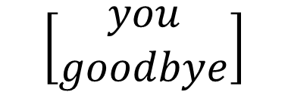
통계 기반 기법(배치 학습)
추론 기반 기법(미니배치 학습)
SVD
신경망
학습 데이터
학습 데이터
You goodbye and I say hello.
?
확률 분포
$$\left[\begin{aligned}you \\ goodbye\end{aligned}\right]$$
모델
you
say
goodbye
and
I
hello
.

Slide 7





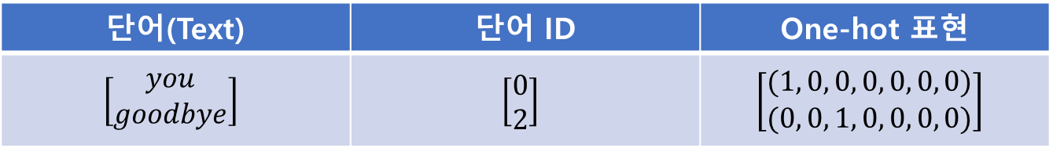








단어(Text) | 단어 ID | One-hot 표현
$$\left[\begin{aligned}you \\ goodbye\end{aligned}\right]$$ | $$\left[\begin{aligned}0 \\ 2\end{aligned}\right]$$ | $$\left[\begin{aligned}(1, 0, 0, 0, 0, 0, 0) \\ (0, 0, 1, 0, 0, 0, 0)\end{aligned}\right]$$
$$you$$
$$say$$
$$goodbye$$
$$(1, 0, 0, 0, 0, 0, 0)$$
$$(0, 1, 0, 0, 0, 0, 0)$$
$$(0, 0, 1, 0, 0, 0, 0)$$
$$you$$
$$say$$
$$goodbye$$
$$and$$
$$I$$
$$hello$$
$$.$$
Input layer

Slide 8







단어(Text) | 단어 ID | One-hot 표현
$$\left[\begin{aligned}you \\ goodbye\end{aligned}\right]$$ | $$\left[\begin{aligned}0 \\ 2\end{aligned}\right]$$ | $$\left[\begin{aligned}(1, 0, 0, 0, 0, 0, 0) \\ (0, 0, 1, 0, 0, 0, 0)\end{aligned}\right]$$
$$you$$
$$say$$
$$goodbye$$
$$(1, 0, 0, 0, 0, 0, 0)$$
$$(0, 1, 0, 0, 0, 0, 0)$$
$$(0, 0, 1, 0, 0, 0, 0)$$
$$you$$
$$say$$
$$goodbye$$
W
(7 x 3)
$$and$$
$$I$$
$$hello$$
$$.$$
Input layer
hidden layer

Slide 9

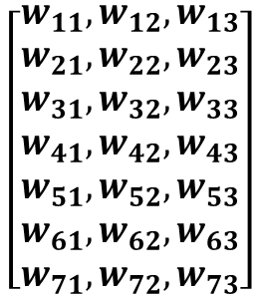


$$\left[\begin{aligned}w_{11},w_{12},w_{13} \\ w_{21},w_{22},w_{23} \\ w_{31},w_{32},w_{33} \\ w_{41},w_{42},w_{43} \\ w_{51},w_{52},w_{53} \\ w_{61},w_{62},w_{63} \\ w_{71},w_{72},w_{73}\end{aligned}\right]$$
$$\left[1 , 0 , 0 , 0 , 0 , 0 , 0 \right]$$
$$×$$
$$\left[w_{11},w_{12},w_{13}\right]$$
c
(1 x 7)
Win
(7 x 3)
=
h
(1 x 3)

Slide 10
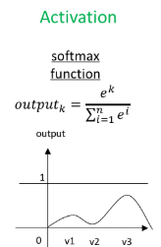
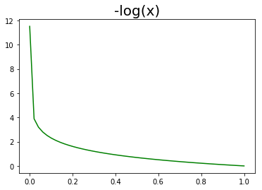





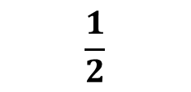
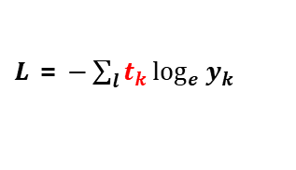



MatMul
정답 레이블 (t)
$$say$$
$$(0, 1, 0, 0, 0, 0, 0)$$
$$you$$
$$(t_{1},t_{2},t_{3},t_{4},t_{5},t_{6},t_{7})$$
$$(1, 0, 0, 0, 0, 0, 0)$$
SCORE
Probability
Win
MatMul
Softmax
Cross
Entropy
Error
+
X
$$Loss$$
$$\frac{1}{2}$$
Wout
MatMul
여러 클래스를 처리하려는 경우
$$goodbye$$
$$(0, 0, 1, 0, 0, 0, 0)$$
Win
$L$ = $−\sum_{l}{t_{k}\log_{e}{y_{k}}}$

Slide 11


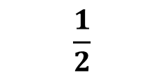


MatMul
$$you$$
$$(1, 0, 0, 0, 0, 0, 0)$$
Win
MatMul
+
X
SCORE
$
$$\frac{1}{2}$$
Wout
MatMul
$$goodbye$$
$$(0, 0, 1, 0, 0, 0, 0)$$
Win

Slide 12
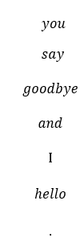









$$you$$
0
Win
(7 x 3)
$$say$$
1
$$goodbye$$
0
Softmax
Wout
(3 x 7)
$$and$$
0
$$I$$
0
Win
(7 x 3)
$$hello$$
0
$$.$$
0
출력층(점수)
확률
정답 레이블
Input layer
hidden layer

Slide 13
$$you$$
0
Win
(7 x 3)
$$say$$
1
$$goodbye$$
0
Softmax
Wout
(3 x 7)
$$and$$
0
$$I$$
0
Win
(7 x 3)
$$hello$$
0
$$.$$
0
출력층(점수)
확률
정답 레이블
Input layer
hidden layer

Slide 14
MatMul
정답 레이블 (t)
$$say$$
$$(0, 1, 0, 0, 0, 0, 0)$$
$$you$$
$$(t_{1},t_{2},t_{3},t_{4},t_{5},t_{6},t_{7})$$
$$(1, 0, 0, 0, 0, 0, 0)$$
SCORE
Win
MatMul
Softmax
With
Loss
+
X
$$Loss$$
$$\frac{1}{2}$$
Wout
MatMul
$$goodbye$$
$$(0, 0, 1, 0, 0, 0, 0)$$
Win

Slide 15
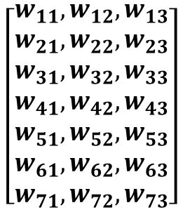
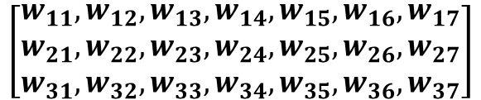
$$\left[\begin{aligned}w_{11},w_{12},w_{13} \\ w_{21},w_{22},w_{23} \\ w_{31},w_{32},w_{33} \\ w_{41},w_{42},w_{43} \\ w_{51},w_{52},w_{53} \\ w_{61},w_{62},w_{63} \\ w_{71},w_{72},w_{73}\end{aligned}\right]$$
$$\left[\begin{aligned}w_{11},w_{12},w_{13},w_{14},w_{15},w_{16},w_{17} \\ w_{21},w_{22},w_{23},w_{24},w_{25},w_{26},w_{27} \\ w_{31},w_{32},w_{33},w_{34},w_{35},w_{36},w_{37}\end{aligned}\right]$$
Win
(7 x 3)
Wout
(3 x 7)

Slide 16
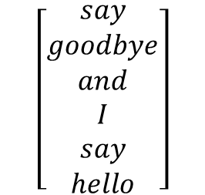
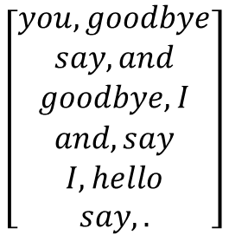
말뭉치
맥락(contexts)
타깃
you say goodbye and I say hello.
you say goodbye and I say hello.
you say goodbye and I say hello.
you say goodbye and I say hello.
you say goodbye and I say hello.
you say goodbye and I say hello.
$$\left[\begin{aligned}you, goodbye \\ say, and \\ goodbye, I \\ and, say \\ I, hello \\ say, .\end{aligned}\right]$$
$$\left[\begin{aligned}say \\ goodbye \\ and \\ I \\ say \\ hello\end{aligned}\right]$$
말뭉치
맥락(contexts)
타깃
[[0 2],
[1 3],
[2 4],
[3 1],
[4 5],
[1 6]]
[1
2
3
4
5
6]
[0, 1, 2, 3, 4, 5, 6]
Shape (8, )
Shape (6, 2)
Shape (6, )

Slide 17
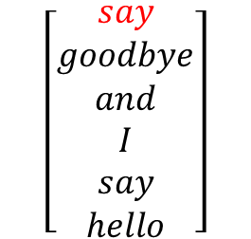
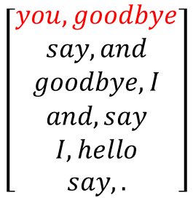
맥락(contexts)
타깃
맥락(contexts)
타깃
맥락(contexts)
타깃
[[[1 0 0 0 0 0 0],
[0 0 1 0 0 0 0]],
[[0 1 0 0 0 0 0],
[0 0 0 1 0 0 0]]
[[0 0 1 0 0 0 0],
[0 0 0 0 1 0 0]],
[[0 0 0 1 0 0 0],
[0 1 0 0 0 0 0]]
[[0 0 0 0 1 0 0],
[0 0 0 0 0 1 0]],
[[0 1 0 0 0 0 0],
[0 0 0 0 0 0 1]]]
$$\left[\begin{aligned}you, goodbye \\ say, and \\ goodbye, I \\ and, say \\ I, hello \\ say, .\end{aligned}\right]$$
[[0 2],
[1 3],
[2 4],
[3 1],
[4 5],
[1 6]]
[1
2
3
4
5
6]
[[0 1 0 0 0 0 0]
[0 0 1 0 0 0 0]
[0 0 0 1 0 0 0]
[0 0 0 0 1 0 0]
[0 0 0 0 0 1 0]
[0 0 0 0 0 0 0]]
$$\left[\begin{aligned}say \\ goodbye \\ and \\ I \\ say \\ hello\end{aligned}\right]$$
Shape (6, 2)
Shape (6, )
Shape (6, 2, 7)
Shape (6, 7)

Slide 18

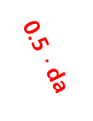

MatMul
정답 레이블 (t)
$$say$$
$$(0, 1, 0, 0, 0, 0, 0)$$
$$you$$
$$(t_{1},t_{2},t_{3},t_{4},t_{5},t_{6},t_{7})$$
$$(1, 0, 0, 0, 0, 0, 0)$$
SCORE
Win
MatMul
Softmax
With
Loss
0.5 $∙$da
+
X
$$Loss$$
0.5 $∙$ da
da
ds
1
$$\frac{1}{2}$$
Wout
MatMul
$$goodbye$$
0.5$∙$da
$$(0, 0, 1, 0, 0, 0, 0)$$
Win

